Slide 1
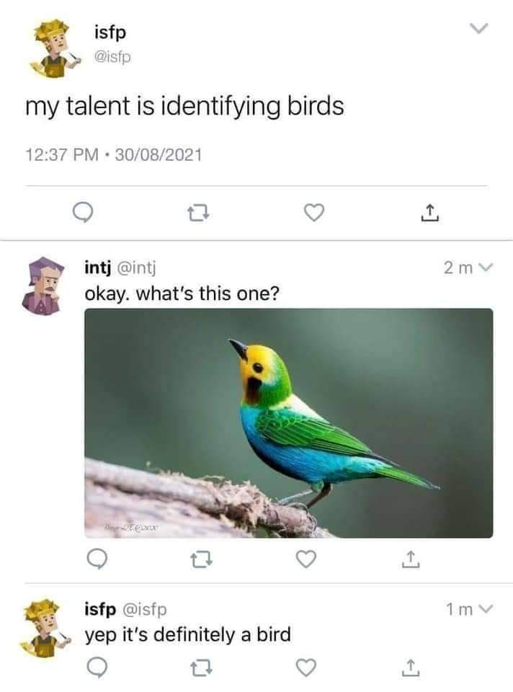

Slide 2
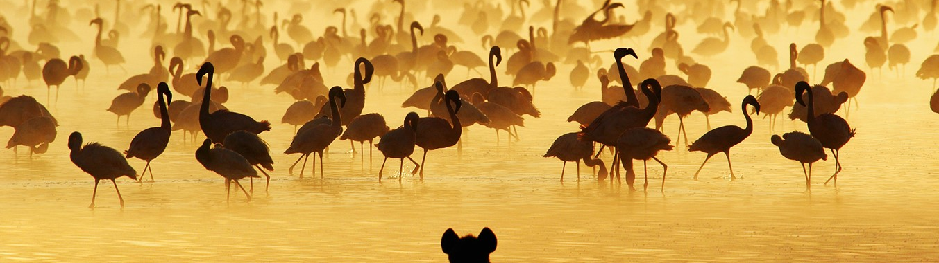

BirdBrain.AI Unlock the secrets of the skies* with BirdBrain.AI
Team: Avian Analysts
July 24, 2023
*Flightless birds included

Slide 3

Agenda
Introduction
Motivation, Project Goal
Application
Data set, Architecture, Model, Evaluation
Demo
Conclusion
Challenges, Summary, Outlook

Slide 4



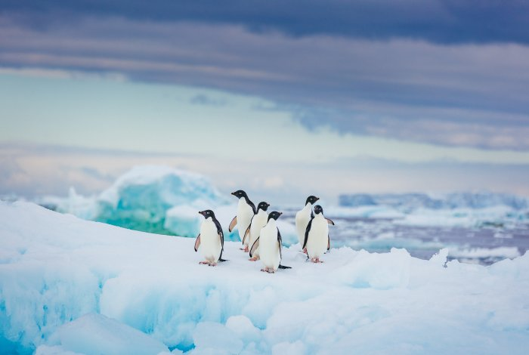

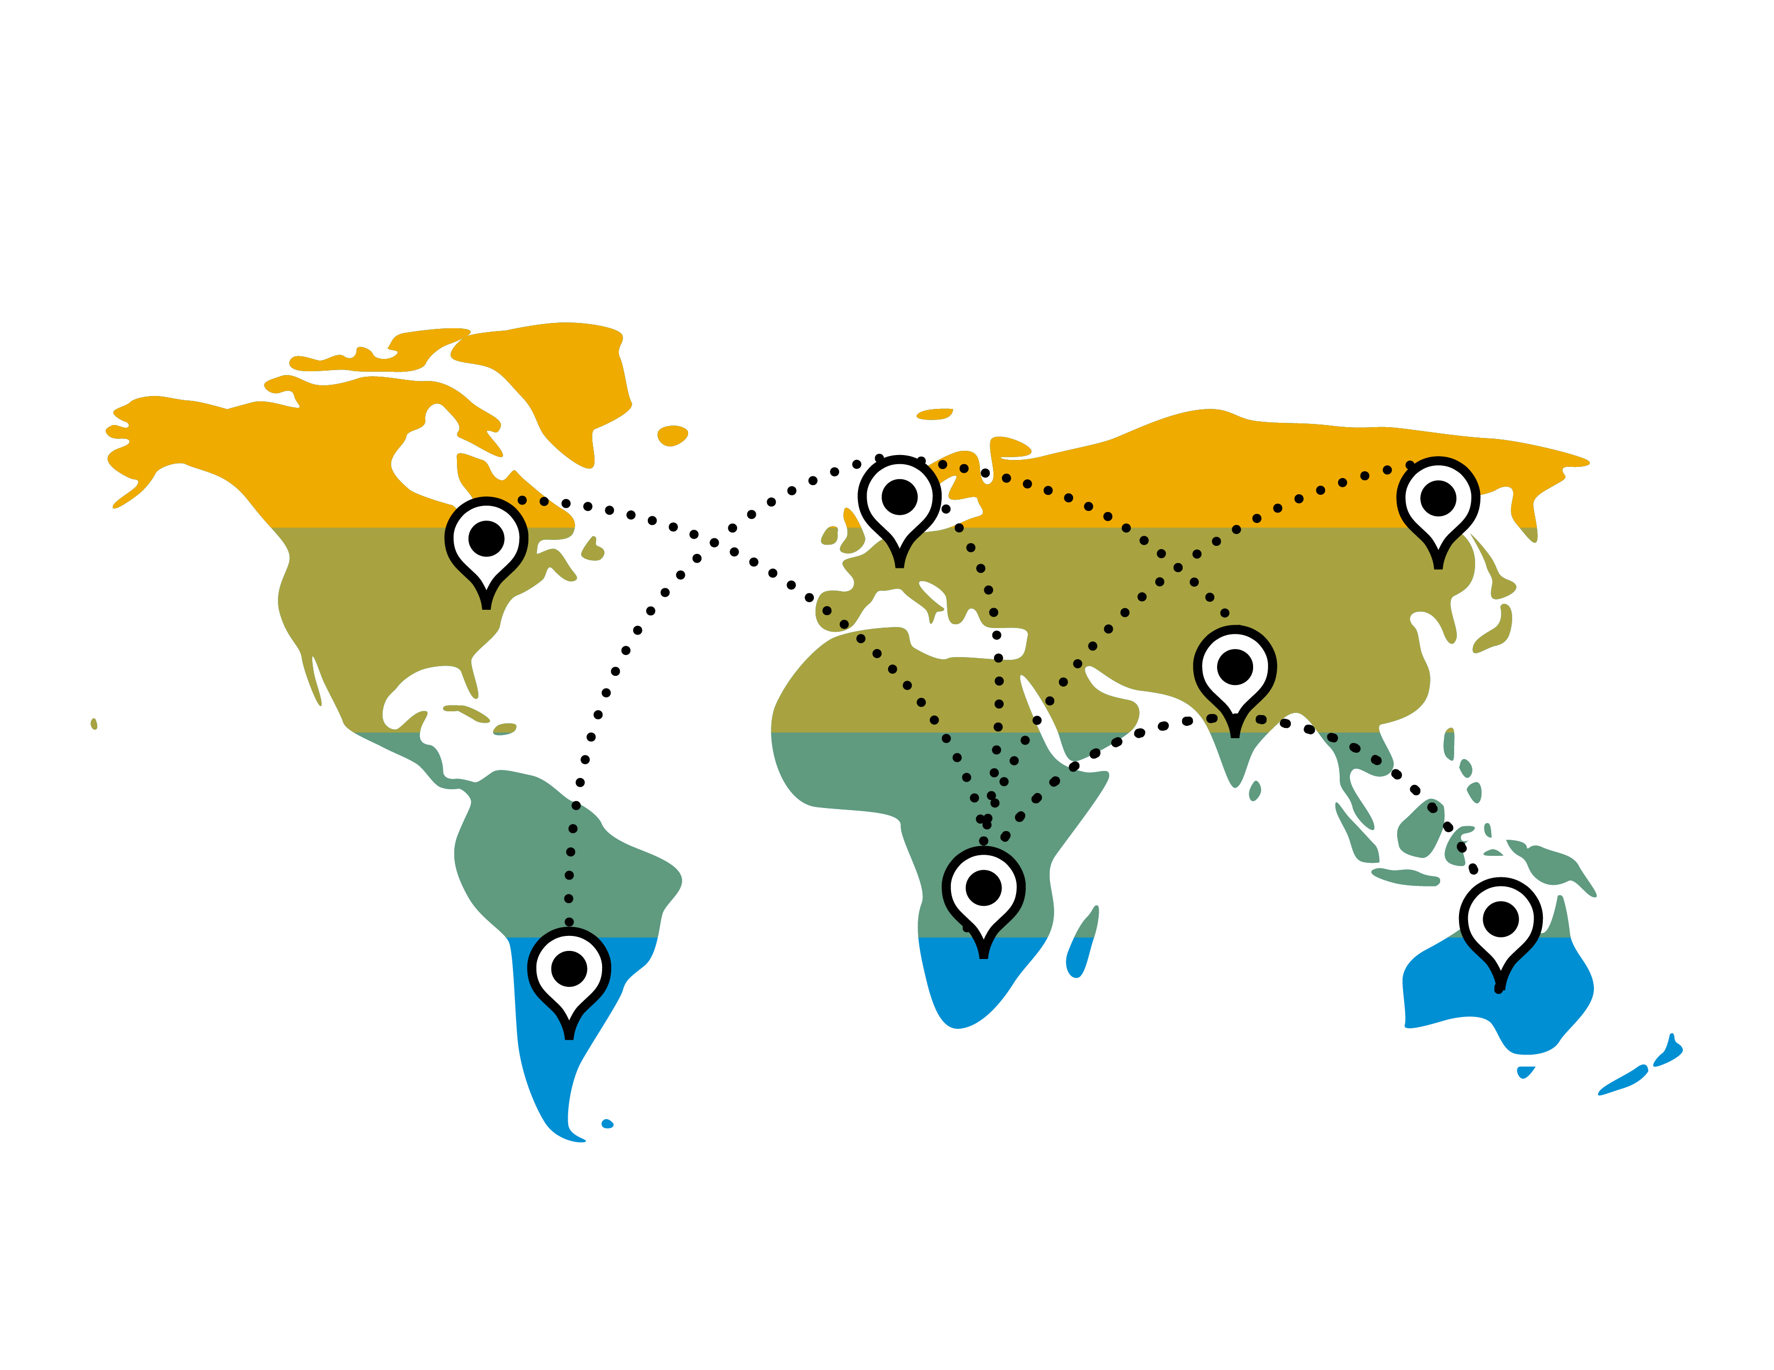
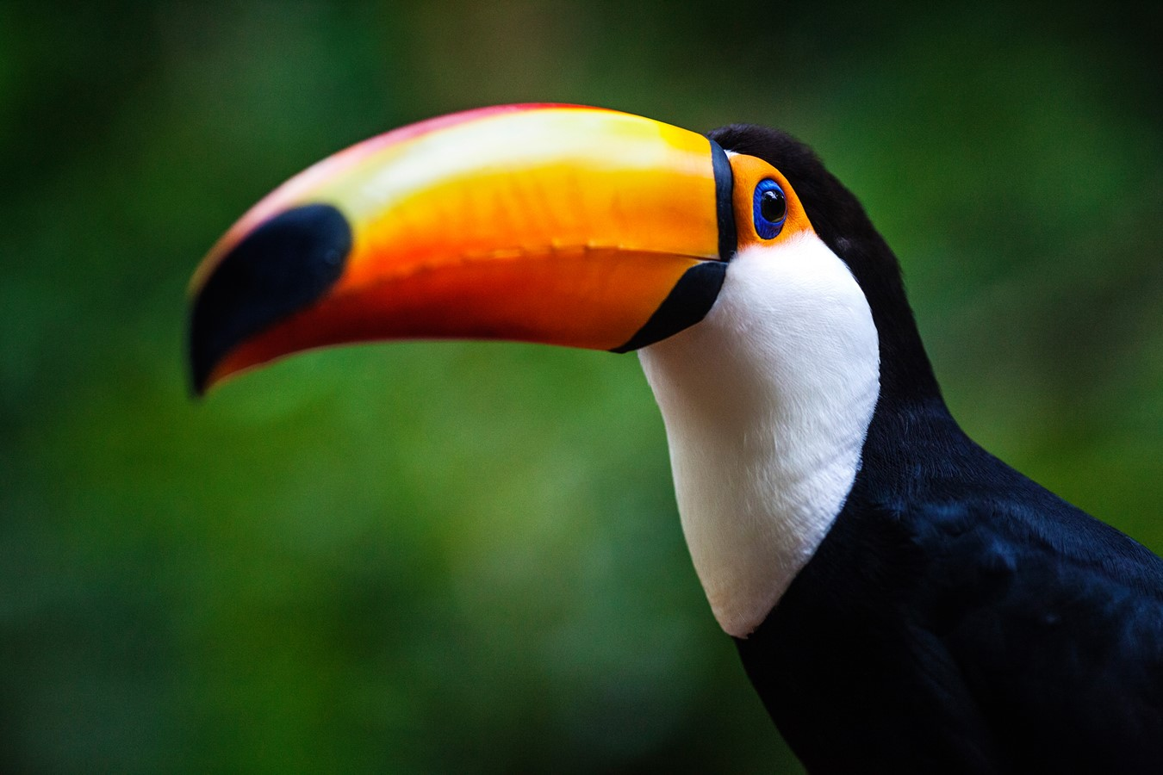

Motivation
Educational purposes
Bird identification and photography
Monitoring endangered species
Ecotourism / Birdwatching
Notes:
Educational purpose : ✅
Use bird classification teach students biology , ecology, environmental science
Ecoturism: ✅
Lighter carbon footprint
Only love to watch and study -> protect natural habitats and wildlife
Travel long distances to spot rare species
Multi-billion dollar ecoturism industry
Birding / Birdwatching with technology: ✅
"It's made it easier to get the information you need to identify birds and figure out where to find them.
Identify birds by their appearance other apps by appearance ans songs
Other alert you when rare bird is spotted in your area
Montioring endagered species: ✅
Ai can identify which images contain rare species
Reduce manual labor to collect onservation data
Helping to protect species
Conservationists had been using automated cameras to capture species,
Bird indentification: ✅
Most dificult tasks for beginners
Struggle with identifying birds
Some bird look familiar
Help identify bird more easily
---------------------------------------------------
Wildlife photography : Bird classification can be used to enhance the experience of wildlife photographers by helping them identify and learn more about the species they capture, improving their knowledge and appreciation of the natural world.
Ecotourism: Birdwatching is a popular ecotourism activity, and bird classification in pictures can help tourists identify the species they encounter, enriching their experience and fostering a greater appreciation for wildlife and conservation efforts.
Birdwatching: Birdwatching enthusiasts can use apps to identify birds they observe in the wild. This can enhance their experience and help them keep track of the different species they've spotted.
Monitoring endangered species: Identifying bird species in pictures can help track the presence and distribution of endangered species, providing valuable data for conservation efforts.
Educational purposes: Teachers can use bird classification in pictures as an engaging way to teach students about biology, ecology, and environmental science, helping to inspire the next generation of scientists and conservationists.

Slide 5



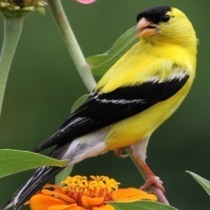
Project Goal
Data Set
CV Model
Knowledge Base
Application
Classification
CNN
BIRDS 525 SPECIES – IMAGE CLASSIFICATION
„American Goldfinger“
API Accesses
Website
Notes:
Bird Species classification Web Application
Utilizes Kaggle dataset of 525 bird species
Image recognition for bird classification on provided input image
Provide detailed information of identified bird species
Simplified method for bird enthusiasts to identify different birds
Web application for identifying different species of birds (classify)
Image recognition to classify birds based on provided bird input image
Simplified method for bird enthusiasts to identify different birds
Provide detailed information of identified bird
Short summary
Whole Wikipedia page

Slide 6
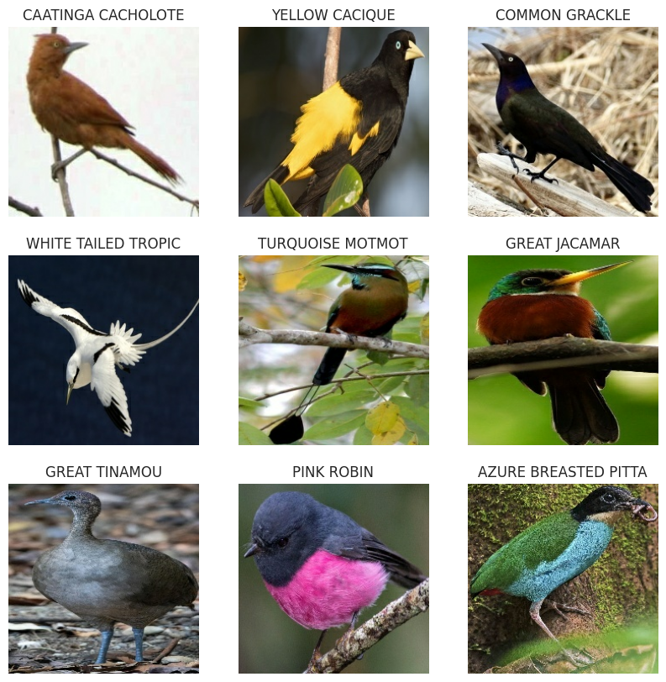
Data Set
BIRDS 525 SPECIES – IMAGE CLASSIFICATION
89.884 images in 525 classes
224x224x3 jpg images
~ 85k train images
Min/Max number of samples: 140/273
~ 80% of classes have 150-200 samples
~ 2,6k test/valid images (5 images/class)
Peculiarities
High quality images
Male/Female ratio 80/20
Test / Validation sets mainly male birds

Slide 7
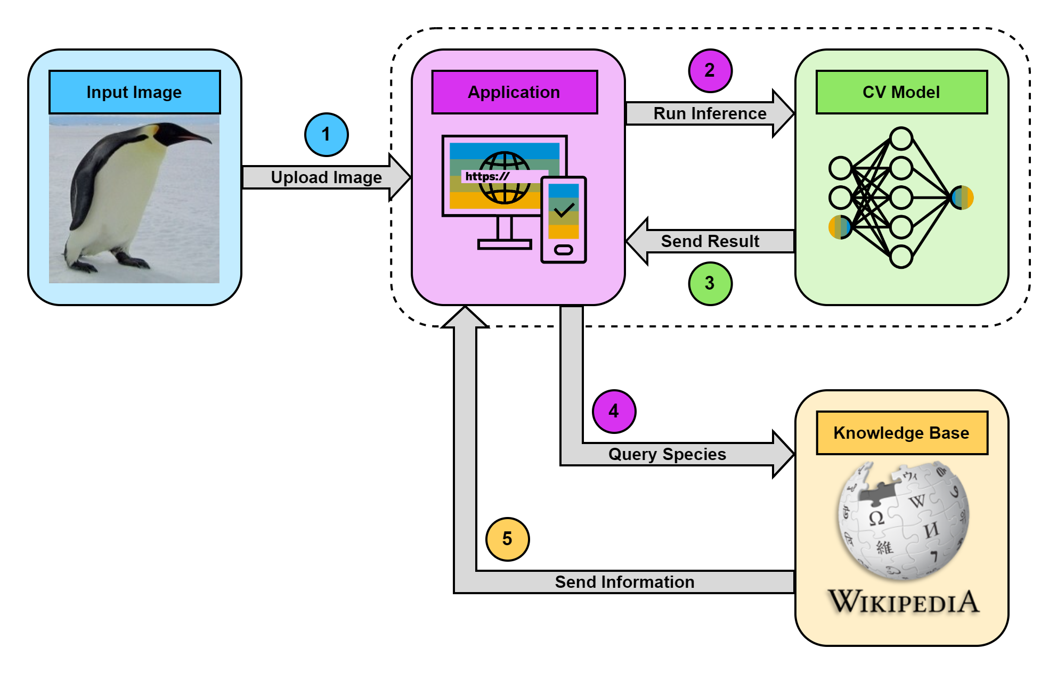
Architecture

Slide 8
Front- and Backend
Frontend
Backend
Next.js
Simple user interface
Single-page application
Upload image for classification
Display uploaded image and name of bird species
Show either Wikipedia summary or page of species
API endpoints using FastAPI
Integration of model for bird image classification
Submission of input to backend
Google Search: Search for Wikipedia page of bird species
Wikipedia integration: summary or page
Send content back to frontend
Notes:
Frontend:
Usage of Next.js
CSS for styling the page
Upload button:
bird image to classify it with model
Display uploaded image
Show name of classified bird species
(Radio button) possibility to Choose between :
Wikipedia summary
Entire page of identified bird species
Simples ui -> one page application
Backend:
FastAPI to built API endpoints
Integration of model for classifying bird images as per species
Submission of input image to backend or model for classification
Googleseach :
Search for wikipedia page of identified bird species
Wikipedia:
Short Summary
Entire Wikipedia page
Sending content (summary or page and name of species) back to frontend

Slide 9
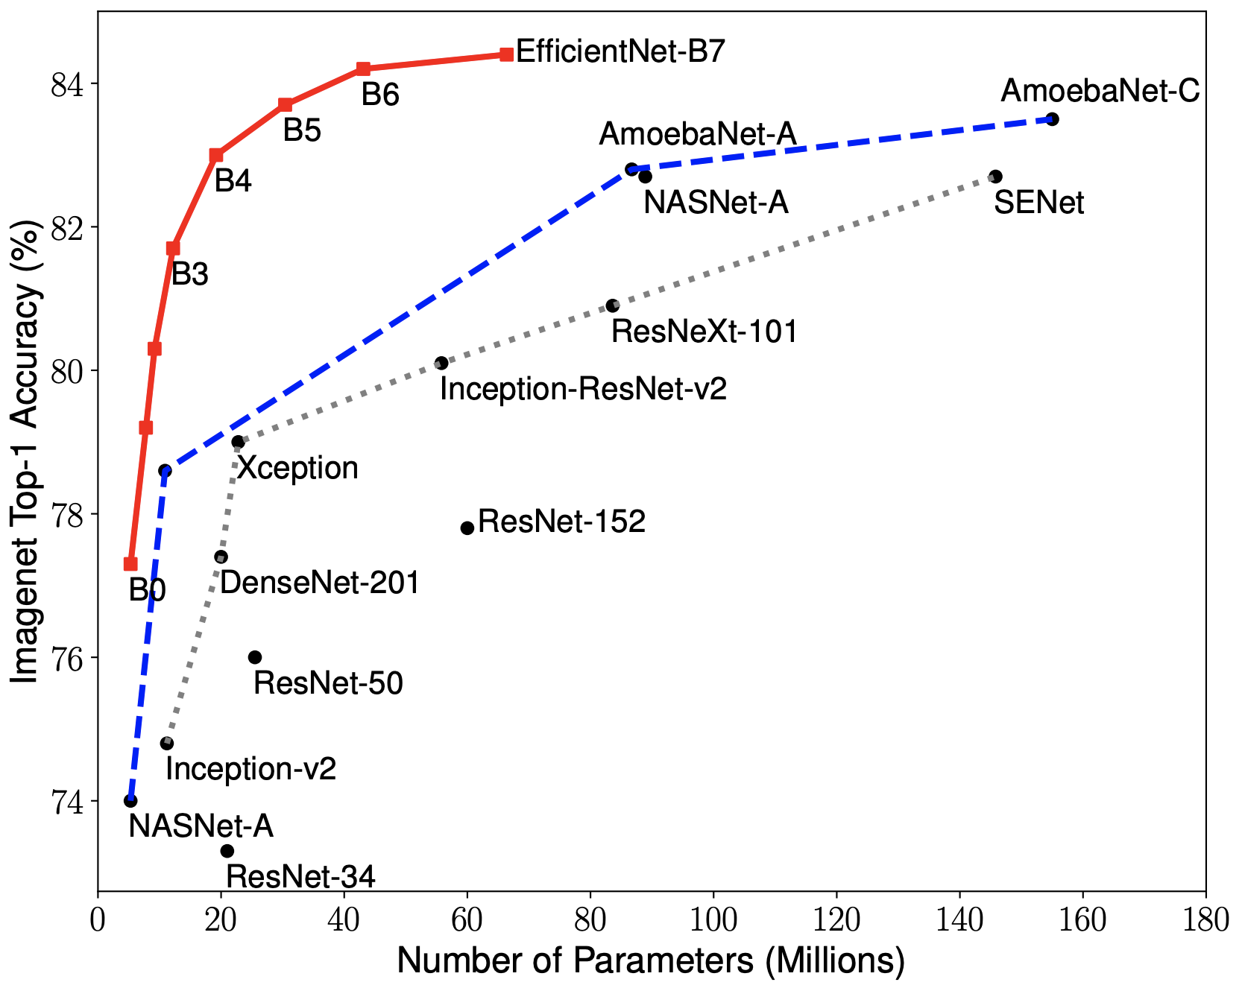
Model - EfficientNet
Developed by Google Researchers
Uses compound scaling
Scales depth, width and resolution all together
Strong baseline model
Benefits:
Parameter ▼ Performance ▲
Computing cost ▼ Accuracy ▲
https://arxiv.org/pdf/1905.11946.pdf

Slide 10
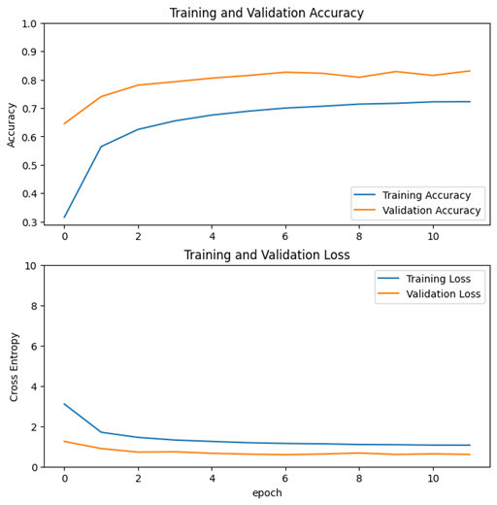
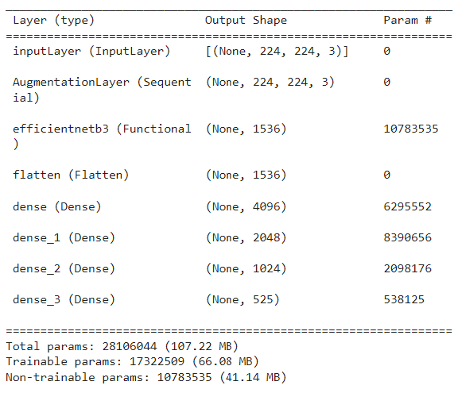
Model - Implementation
Augmentation Layer
Rotation, Flipping, Zoom
Translation, Contrast
EfficientNetB3
Not trainable
Classification Layer
Image size ▲
Number of classes ▲
Number of Neurons ▲

Slide 11
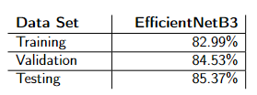
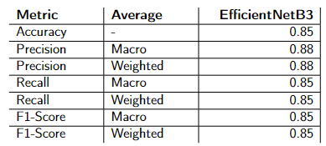
Evaluation - Performance
Perfect predicted classes
Precision/Recall/F1-Score = 1.0
168 of 525 classes
Good predicted classes
Precision >= 0.75
408 of 525 classes
Performance across all sets
Medium predicted classes
0.25 < Precision < 0.75
114 of 525 classes
Bad predicted classes
Precision <= 0.25
3 of 525 classes
Classification Report Summary
Precision as metric as false predictions are expensive

Slide 12
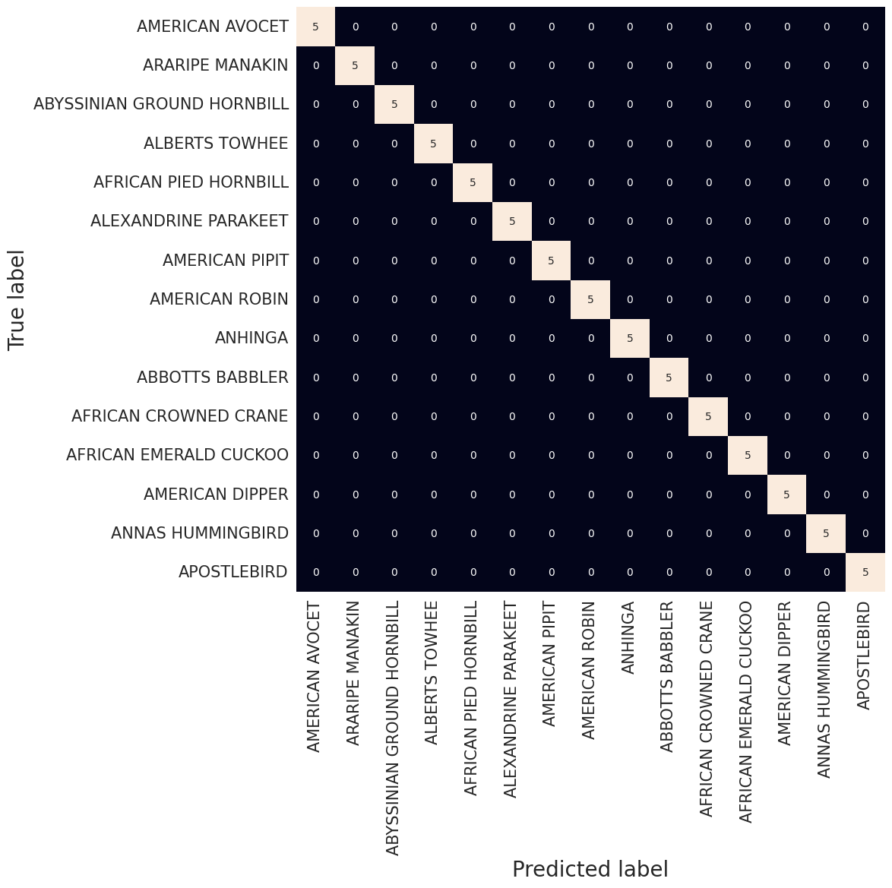
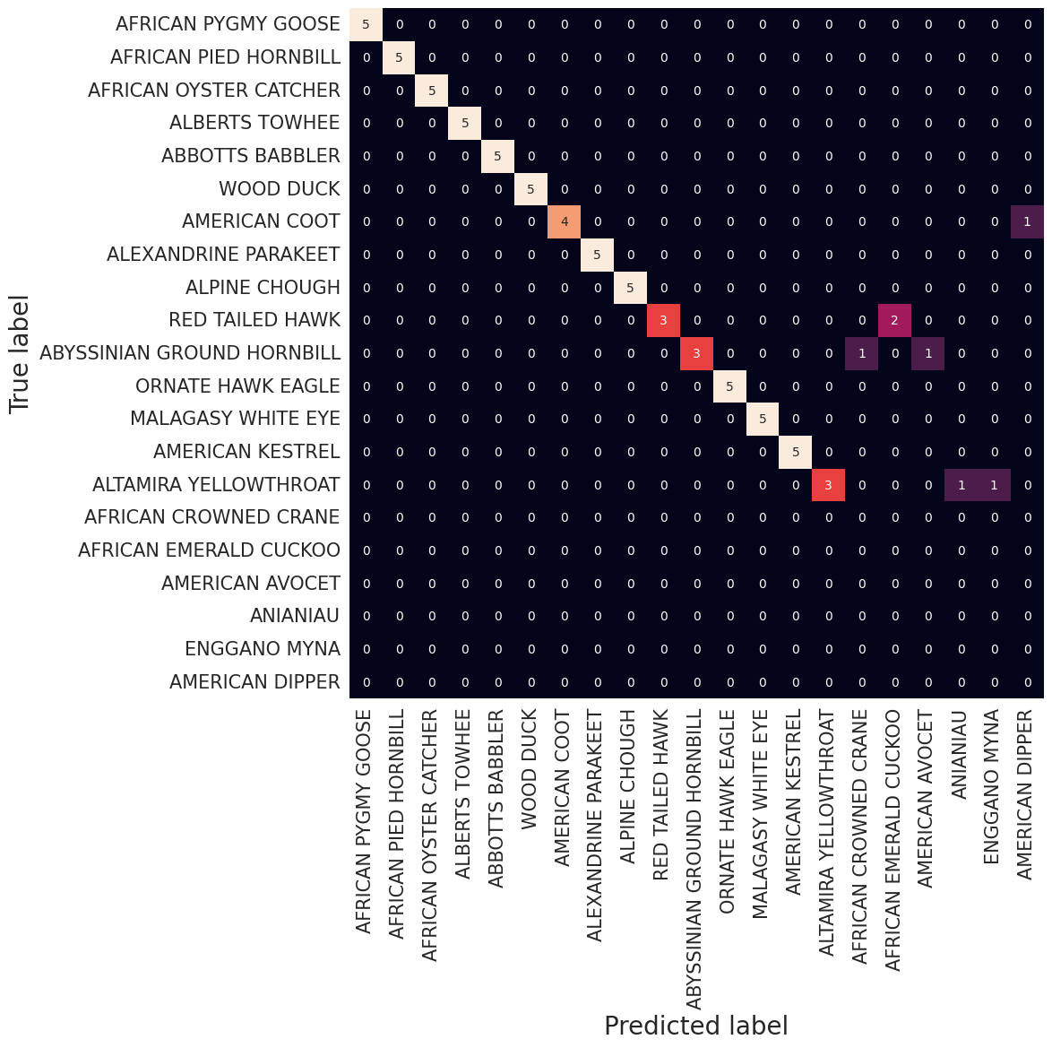
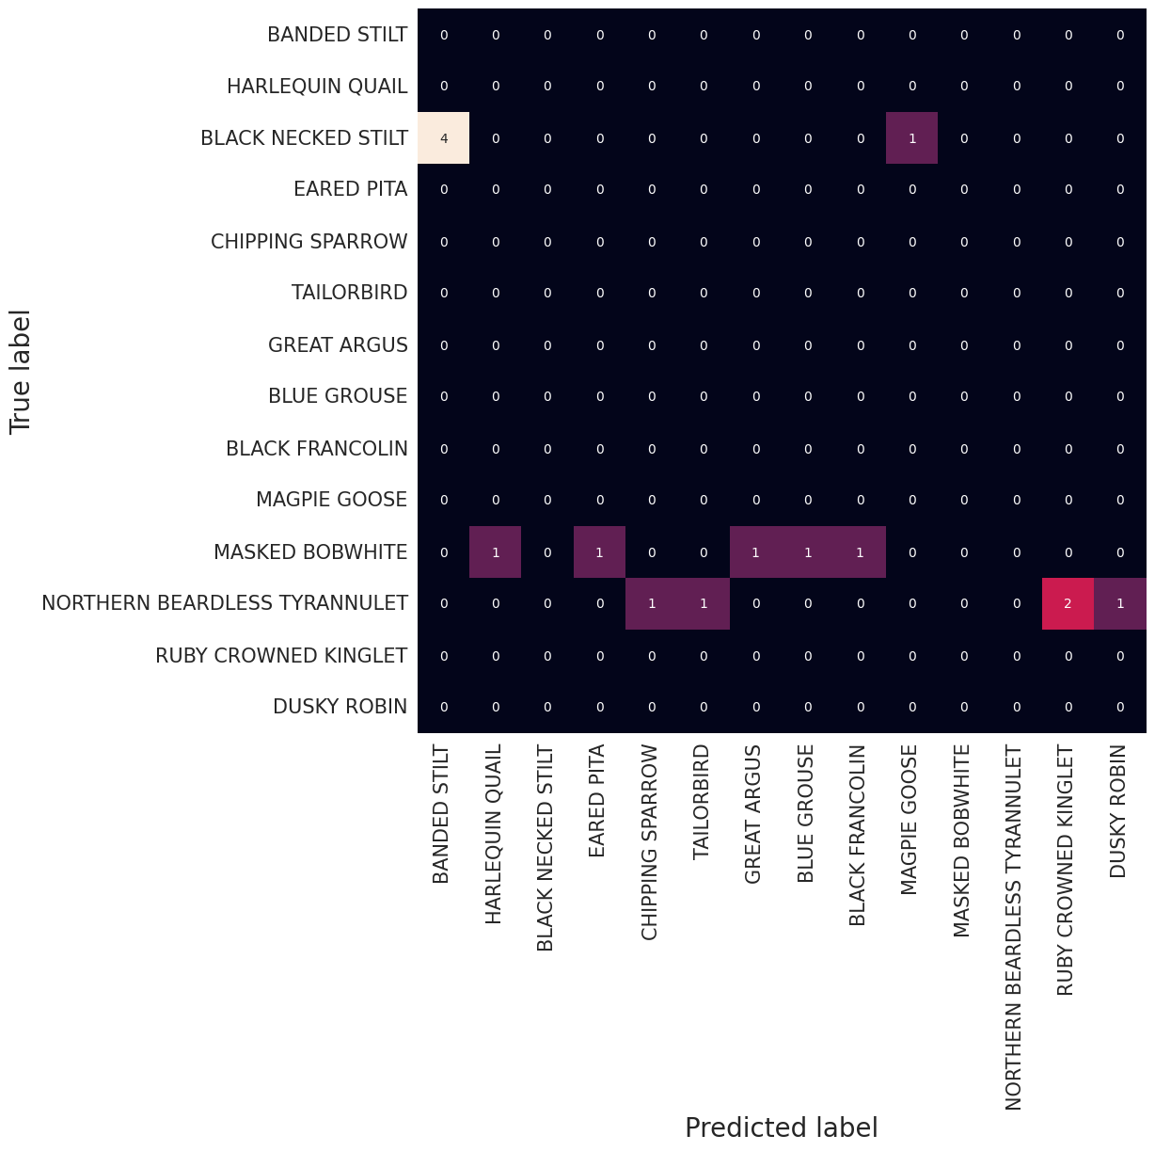
Evaluation – Confusion Matrices
Perfect predicted Classes
Good predicted classes
Bad predicted classes

Slide 13
DEMO

Slide 14





Challenges
Model not savable in TF 2.12
Entries not found
Model Architecture
Upgrade on TF 2.13 fixed the bug
Workaround via Google Search
EfficientNetB3
More neurons in classification layers

Slide 15


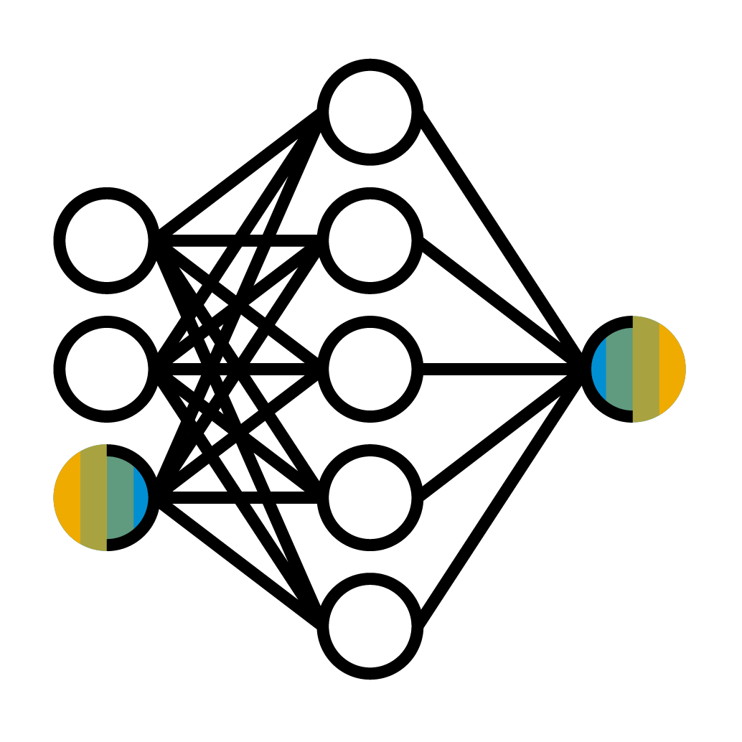


Conclusion
Summary
Outlook
Bird Detection
Live Classification
Performance Boost
Try different models
Focus on female birds

Slide 16
Q & A

Slide 17

Thank you.
© 2023 SAP SE or an SAP affiliate company. All rights reserved. See Legal Notice on www.sap.com/legal-notice for use terms, disclaimers, disclosures, or restrictions related to SAP Materials for general audiences.

Slide 18
Image Sources
Pictograms: https://www.sapbrandtools.com/
Bird Images: https://www.kaggle.com/datasets/gpiosenka/100-bird-species
Kaggle Logo: https://upload.wikimedia.org/wikipedia/commons/7/7c/Kaggle_logo.png?20140912155123
Wikipedia Logo: https://upload.wikimedia.org/wikipedia/commons/thumb/8/80/Wikipedia-logo-v2.svg/2244px-Wikipedia-logo-v2.svg.png
TensorFlow Logo: https://upload.wikimedia.org/wikipedia/commons/thumb/a/ab/TensorFlow_logo.svg/1200px-TensorFlow_logo.svg.png
Docker Logo: https://www.docker.com/wp-content/uploads/2022/03/horizontal-logo-monochromatic-white.png
All other images/illustrations are selfmade

Slide 19
Additional Sources
Ecoturism and Birdwatching:
https://www.onthefeeder.com/birdwatching-vs-birding/ (zuletzt besucht: 23/07/2023)
https://www.ncbi.nlm.nih.gov/pmc/articles/PMC8656864/ (zuletzt besucht: 23/07/2023)
https://www.himalayan-gypsy.in/bird-watching-and-ecotourism/ (zuletzt besucht: 23/07/2023)
https://badgerlandbirding.com/2023/04/23/whats-the-difference-between-birding-and-bird-watching/?utm_content=cmp-true (zuletzt besucht: 23/07/2023)
https://badgerlandbirding.com/2023/04/23/whats-the-difference-between-birding-and-bird-watching/?utm_content=cmp-true (zuletzt besucht: 23/07/2023)

Slide 20
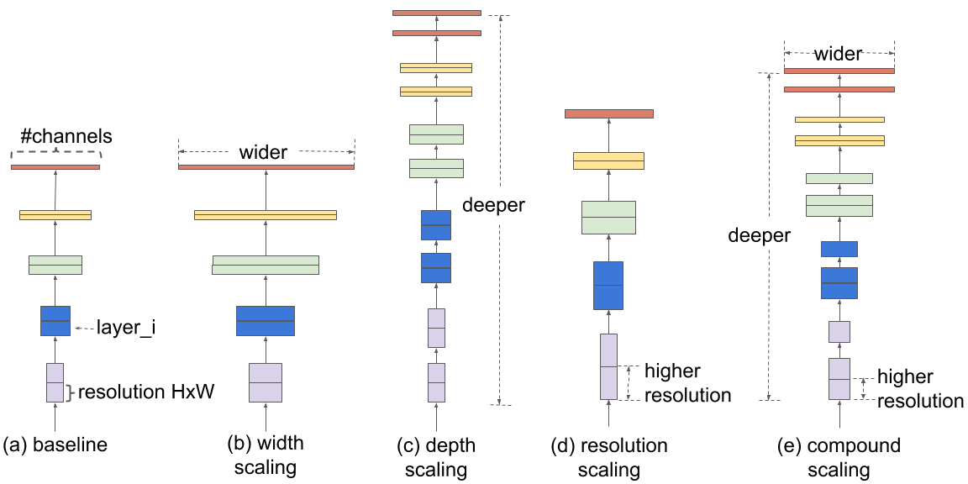
Compound Scaling
https://arxiv.org/pdf/1905.11946.pdf

